Slide 1

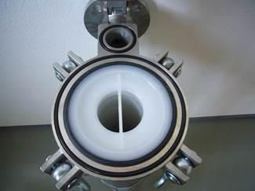
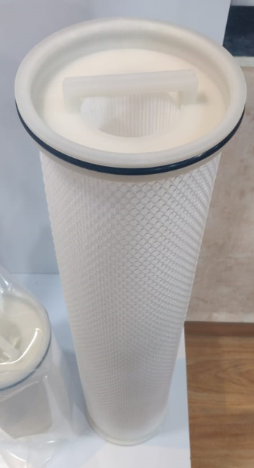
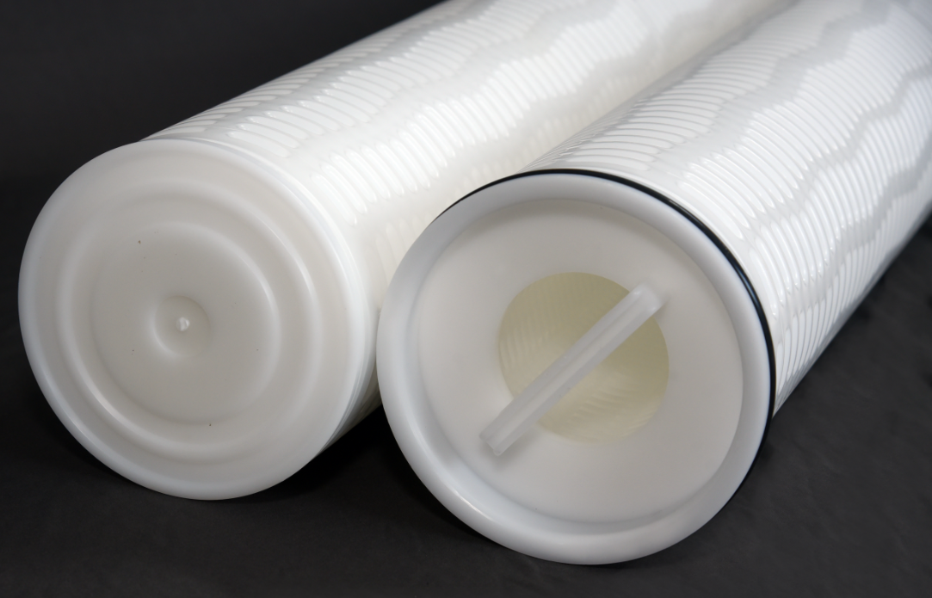
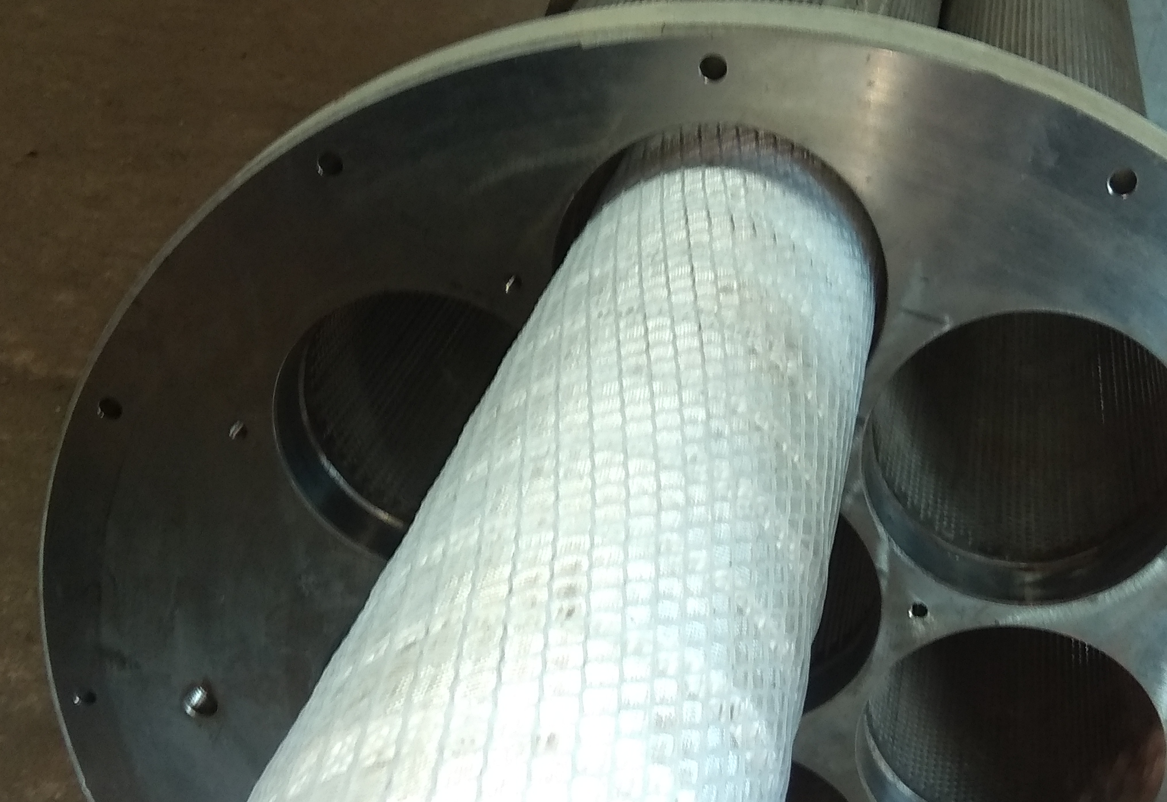
KGT LARGE FLOW FILTER
ABOUT
The KGT Large Flow filter is a large diameter filter having single open ended design with option of pleated and depth media.
The flow pattern is from the inside to the outside of the filter element. Special pleated structure with large diameter of 6 inches; with lengths from 20 inches up to 60 inches, the filter boasts of a capacity of up to 1500 lpm per cartridge.
The KGT Large flow filter is available in polypropylene and glass fibre to handle a wide range of liquids.
ADVANTAGES
Due to large flow capacity, filter system can be designed up to 50% smaller footprint when compared to standard filter of 2.5” diameter and 40” length.
Each KGT Large Flow filter replaces upto 20 small diameter elements for the same flow.
Reproducible performance by virtue of absolute removal rating
Available in 10/20/30/40/60 inches length
All polymeric construction ensures minimal disposal costs.
The contamination is trapped within the filter due to inside to outside flow pattern, benefitting clean filter changeover.
DIFFERENCIAL PRESSURE DATA
For Normal Flow from Inside to Outside for liquids compatible with the filter media, the maximum differential pressure is
Polypropylene Medium: 36psid (2.5 bard)@75⁰C
Glass Fibre Medium: 36psid (2.5 bard)@110⁰C
(This data is compiled for Water Service)
APPLICATIONS
Process Water RO Pre-filtration
Amine, Glycol Brine, Seawater
White Fuels Naphtha, HC Condensate

Slide 2
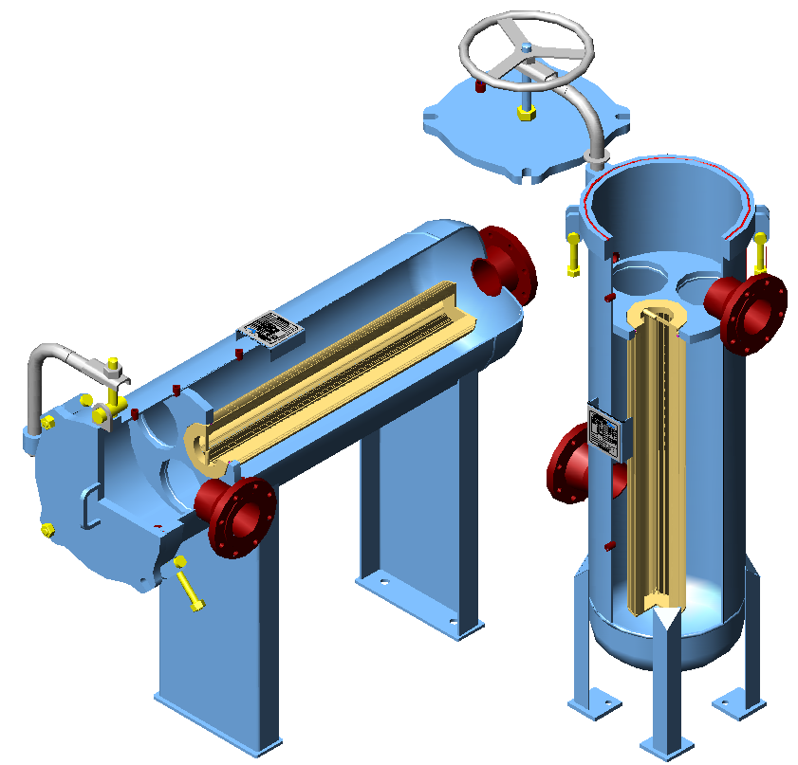
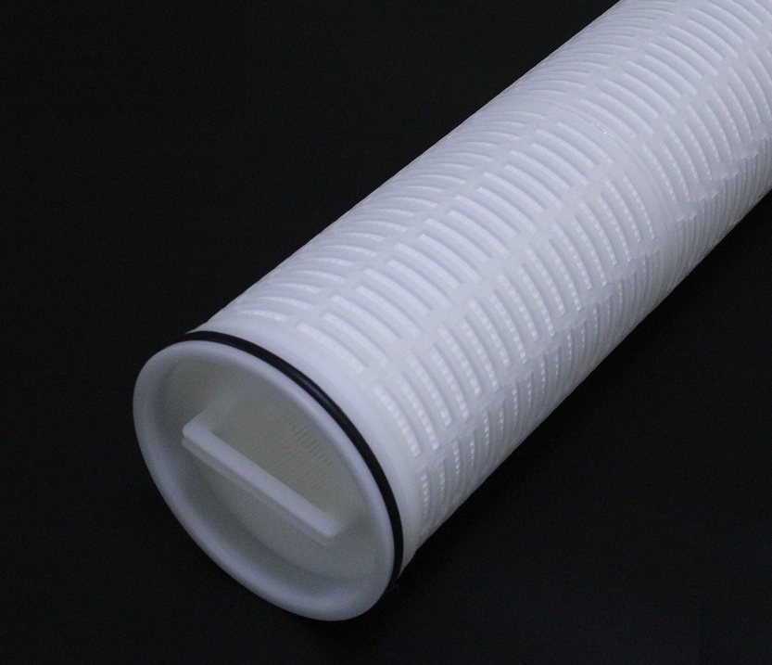
KGT LARGE FLOW FILTER
PART NUMBERING GUIDE
Filter Element Part Number : KGT - - 06 - - HF - -
Short Code Removal Rating Clean Pressure Drop Across Element (mbar/m3/hr)
ƞ > 99.9% 20 inches 40 inches 60 inches
020 2 μm 5.00 2.40 2.10
050 5 μm 2.70 1.26 1.08
100 10 μm 1.65 0.96 0.69
200 20 μm 1.23 0.81 0.57
400 40 μm 0.93 0.54 0.27
1000 100 μm 0.66 0.30 0.15
(Values are for Water at 25°C)
Short Code Description Filter Area
Length (inches) m2 (GF/PP)
0620 20 2.8 / 2.55
0640 40 5.4 / 5.1
0660 60 8.1 / 7.65
Filter Media
Short Code Material Of Construction
PP Polypropylene
GF Glass Fibre
Filter Vessels/skids possible in CS, SS, PP, PP/FRP construction to suit process conditions.
‘O’ – ring Seal
Short Code Material Of Construction
N Nitrile
E EPDM
S Silicone
V Viton® A
Viton® is a registered trademark of Chemours Company.
 6, Anurag, Rajaji Path, Ramnagar, Dombivli, Mumbai, 421201, Maharashtra, India
 +91 251 2420878  +91 9166 593 315  solutions@klengas.com

